Slide 1
Green Bank for Appalachia, Energy Communities, and Underserved Rural America
Growing the next generation energy economy in Rural America

Slide 2
Vision:
The Green Bank for Rural America will grow the next generation energy economy, supporting thousands of businesses and create thousands more quality jobs in economically distressed communities while reducing the carbon footprint in target communities.
This effort will be supported by funding from the EPA Greenhouse Gas Reduction Fund (GGRF), the Appalachian Regional Commission, as well as private investment from corporate and philanthropic partners.
Appalachia and Rural America have powered the economic growth of our nation – from coal, to oil, to natural gas - and the Green Bank will help ensure these communities are well positioned to leverage opportunities presented by the new energy economy.

Slide 3
Green Bank for Rural America
EPA Greenhouse Gas Recovery Fund CCIA application process:
Application Submitted: October 12
Notification as Top Ranked Application: December 15
EPA Interview: January 8
Notification of Selection: ~March 2024
Start of Period of Performance: ~July 2024

Slide 4
Green Bank for Rural America
Contents
Target Communities
Governance
Organizational Structure
Network of Community Lenders
Capitalization and Technical Assistance Subawards
Financial Assistance: Use of Funds/Financial Products
Eligible Projects
TA Hubs and TA Services
Impact Reporting
Timeline / Next Steps

Slide 5
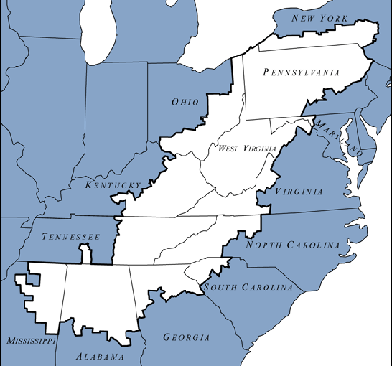
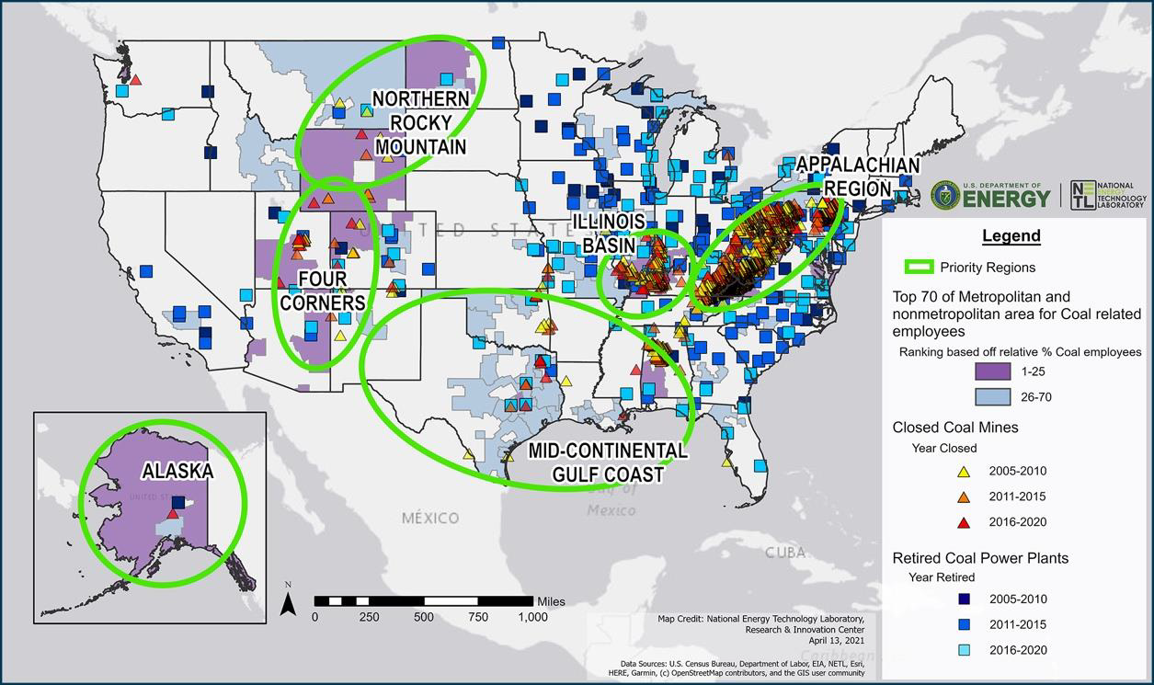
Green Bank for Rural America
Target communities:
Appalachian Region – entire 13 state region.
Energy Communities – see map
Rural Communities
Other geographies with High Impact Projects - TBD

Slide 6
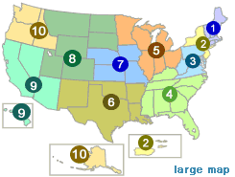
Green Bank for Rural American Will operate in all 10 EPA Regions.
Need not operate in all 50 states.
Need not operate in all counties in a given state.

Slide 7
Green Bank for Rural America - Structure
ACC Board
Green Bank CEO & Management Team
Green Bank Steering Committee
ACC CEO
Technical Assistance Hubs
Leaders/Partners
Energy Production & Storage
Net Zero Emissions Buildings & Housing
Zero Emissions Transportation
Financing Strategies
Community Engagement
Workforce Development
Pass-Thru Awards
Capital and TA
Network of Community Lenders
Eligible Projects
Green Bank Chief of Staff,
Chief Risk Officer, Audit, Compliance
100% owned non-profit subsidiary of ACC
Total Pass-Thru: $900mm
Avg Award = $10mm Capital + $1mm TA
Limited # of higher awards up to $50mm
Appx 100 lenders
Contracts for TA services
Leverage Private Investment

Slide 8
Green Bank for Rural America
Steering Committee / National Partners
Appalachian Community Capital. 34 members that manage +$2 billion in assets targeting Appalachia communities in 13 states and 423 counties.
Coastal Enterprises Inc (CEI). Based in Maine and finances rural nationwide. +$1.5 billion in deployment for business and communities to support good jobs and environmentally sustainable development.
Main Street America (MSA) / NTCIC / National Trust for Historic Preservation. Works in over 1,500 communities nationally with $2 billion in deployments.
Grow America (formerly National Development Council). Nationwide footprint, rural and urban. Over $6 billion in financings for housing, community facilities, business lending, C&I in 500 communities.
Coalfield Development Corporation. Lead workforce development partner. Nationally recognized leader in workforce development located in the heart of Appalachian coal country, works with business, educational partners, and unions to train employees for quality job opportunities.
WV Community Development Hub. Lead Community Engagement partner. Nationally recognized community development leader located in the heart of Appalachian coal country,

Slide 9
Network of Community Lenders
Community Lenders
CDFIs, EDA RLFs, USDA IRPs
State, municipal, Tribal government loan funds
Quasi-government community loan fund – with public purpose
Not-for-profit loan funds
Serve Appalachia, Coal and Energy Communities, and Underserved Rural Communities
Community Engagement commitment
Workforce Development commitment

Slide 10
Capitalization Awards to Community Lenders
Pass-through grants or project subsidy
Most Awards up to $10 million per Community Lender
Exception Framework for Awards up to $50 million per Community Lender
Must be an existing Community Lender to receive an Award
Reporting and compliance requirements

Slide 11
Financial Assistance: Eligible Uses
Eligible uses by Community Lenders include:
Debt – senior and subordinate
Forgivable debt
Tax credit bridge financing
New Markets Tax Credit leverage debt
On-bill financing credit facilities
Aggregation / Warehousing – with potential resale to secondary market
Refinancing products
Lease Financing
Structured Finance Solutions
Equity Investments
Securitization – LLR and interest rate buy down

Slide 12
Eligible Projects
Reduce greenhouse gases, air pollution, and contribute to cleaner environments and communities that wouldn’t be otherwise financed
Priority Projects
Low carbon emissions buildings (including housing) – new or renovated
Distributed energy generation and storage
Zero emissions transportation – cars, buses, trucks, charging infrastructure
Low Income and/or Disadvantaged Communities - by either:
Geography
CEJST-Identified Disadvantaged Communities, or
EJScreen - Identified Disadvantaged Communities
or Income
For Non-Metropolitan Areas: 80% of AMI and 200% of the Federal Poverty Level or
Approved for assistance from income-based federal assistance such as HHS, SNAP, School Lunch, SSI, ALICE, etc., or
Affordable Housing with rents not exceeding 30% of 80% AMI for at least 1/2 of units. Includes LIHTC, Section 8, USDA 514/515, …

Slide 13
Technical Assistance Awards to Community Lenders
10% of Capitalization Funding received
May be used for activities such as:
Supporting pre-development activities (engineering, design, business planning / project development, financial structuring, …)
Procuring training, hiring staff, developing new financial products and internal systems
Community Engagement, visioning, planning, project development
Workforce Development with community colleges, workforce boards, unions, training organizations
TA Hubs will offer TA resources to support Community Lenders

Slide 14
TA Hubs and TA Services
Technical Assistance
HUBS
The Green Bank will establish TA Hubs in areas aligned with Program Goals and Priority Projects
TA Services (webinars, online resources) will be available to all community lenders
CLs can use their TA subgrants to purchase services from these providers
CLs can use their TA subgrants to purchase services from other qualified providers / local providers
Distributed Energy Production/Storage
Net Zero Emissions
Buildings
Zero Emissions Transportation
Financing Strategies
Community Engagement
Workforce
Development

Slide 15
Examples of TA Services offered include:
Development Services:
Business plan / feasibility studies
Market studies / market research
Financial structuring / modeling, pro forma preparation
Engineering, design / architectural
Access to tax credits, utility subsidies
Raising private capital
Structuring solar/wind contracts with local utilities
Clean energy / energy efficiency grant applications
Workforce Development – workforce training and job readiness
Community Engagement – community planning, project visioning, project initiation
Metrics / Measurement Frameworks
Data Hub services: eg risk modeling, forecasting, opportunity mapping / analysis, GIS mapping of projects (in LIDAC communities) and lead generation

Slide 16
Impact Reporting
Community Lenders will report on outputs and outcomes from their green financing, such as:
Greenhouse gas emissions/Other Air Pollutants reduced or avoided
Additional Benefits to LIDAC Communities
Priority Projects financed
Community engagement activities
Workforce development activities
Market transformation metrics
Some metrics are familiar. We will develop templates and training for others
Notes:
Greenhouse gas emissions/Other Air Pollutants reduced or avoided
E.g., CO² emissions avoided; kwh energy savings
Tools being developed and TA offered
Additional Benefits to LIDAC Communities
Seven categories – climate change, clean energy, transportation, housing, training & workforce, legacy pollution, clean water
Tools being developed and TA offered
Priority Projects
Distributed energy generation and storage
MWH financed
Net-zero emissions buildings
Residential housing developed/renovated
Community Facility or Commercial Buildings developed/renovated
Zero-emissions transportation
Vehicles financed
Charging infrastructure financed
Low and disadvantaged community engagement and served
Coal, Energy, and Underserved Rural Communities served
LIDAC communities engaged
Jobs created
People trained
BIPOC businesses supported
Market transformation
Public and Private capital leveraged

Slide 17
Prospective Timeline – accelerated Next Steps
March: notification of selection by EPA?
April - June: negotiation and execution of grant award with EPA
July – September: Green Bank Start-Up:
Hire lead staff
Develop procedures, application materials, selection process
October: open Capitalization Award application
January: approve and issue first Capitalization Awards to Community Lenders.

Slide 18
Green Bank for Appalachia, Energy Communities, and Underserved Rural America
Growing the next generation energy economy in Rural America
https://appalachiancommunitycapitalcdfi.org/oa-program/green-bank-for-appalachia-energy-communities-and-underserved-rural-america/
greenbank@acc1.org

